Slide 1

Data Analysis & Visualisations of IPL
Nithin Veer Reddy | Mohan Dwarampudi |Abhinivesh Palusa | Lokin Sai

Slide 2
MOTIVATION
The art and practice of visualizing data is becoming ever more important in bridging the human-computer gap to mediate analytical insight in a meaningful way. ―Edd Dumbill

Slide 3









MOTIVATION
Raw Data
http://bdaipl.tech

Slide 4
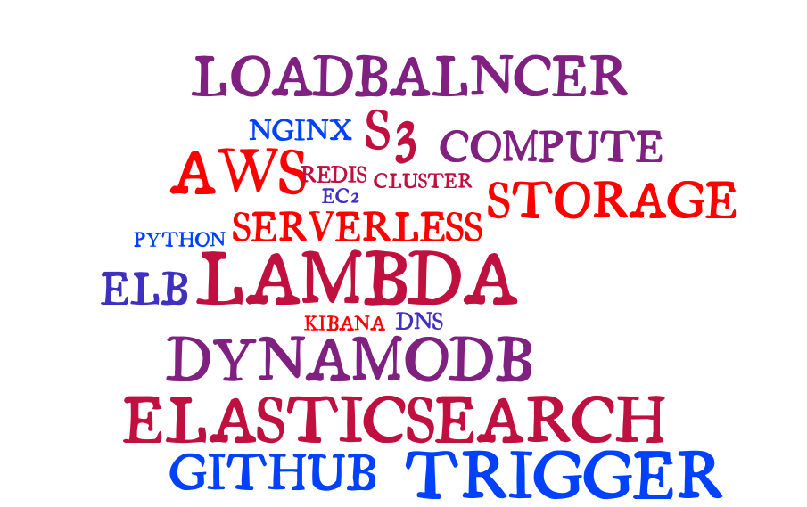
TECH STACK

Slide 5
ETL

Slide 6
EXTRACT
Data has been sourced from multiple areas
Scrapping popular cricket websites
Scrapping wiki
Google API – Geo points
Kaggle competitions
All the data is further stored into S3.

Slide 7
Cont…
Raw data received in S3 is pushed into AWS DynamoDB.
S3event invokes AWS Lambda which does the data parsing before it is rested in DynamoDB.
Three tables – Player, Matches, Deliveries
Data in DynamoDB acts a source of truth for all the further operations.

Slide 8
TRANSFORM
All the semi parsed data should be transformed into a meaningful entity.
Triggers on DynamoDb would invoke AWS Lambda whenever a new entry is added into DynamoDb.
AWS Lambda tunes the data into a meaningful patterns which are further loaded into elasticsearch cluster.
Lambdas would fetch additional geo data from Google API
Lambdas used Redis for a quick key-value mappings.

Slide 9
LOAD
Elasticsearch indexes all the incoming data from lambdas.
Data on elasticsearch is split on the nodes which are part of the cluster.
All the three formats of the data are stored in different indices.

Slide 10
ELASTICSEARCH

Slide 11
KIBANA

Slide 12
DASHBOARDS

Slide 13
Cont…

Slide 14
NGINX

Slide 15

THANKS

